Slide 1
Enagás and TIGF
Coordinated implementation of the Network Code on Capacity Allocation Mechanisms
15 November 2013
20th SG meeting

Slide 2
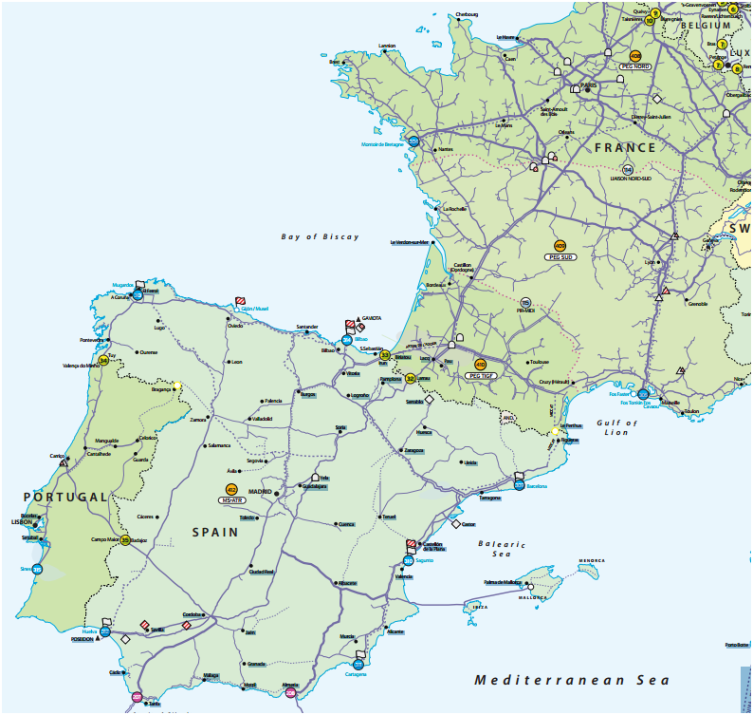
1. VIP
Available capacity at the two existing physical IPs between Spain and France, Irún-Biriatou and Larrau, will be offered at a single VIP. This will imply that as from October 2014 for commercial and operational purposes the physical IPs will no longer exist.
For the calculation of capacities at the VIP between France and Spain, existing technical capacity at the two existing physical IPs between Spain and France have been aggregated.
From 1 October 2014 all existing contracts at the physical interconnection points, Larrau and Biriatou, will be transferred into the VIP between France and Spain.
VIP

Slide 3
2. Bundled capacity
Enagás and TIGF will jointly offer the maximum possible amount of bundled capacity between Spain and France in both flow directions.
According to the CAM NC bundled capacity means a standard capacity product offered on a firm basis which consists of corresponding entry and exit capacity at both sides of every interconnection point. This implies:
Each standard product offered includes the same amount of capacity.
Capacities will be booked through a single allocation procedure.
Capacities will be allocated to the same shipper at both sides of the IP.
Transactions held on the secondary market must not result in unbundling capacities that were previously offered and allocated as bundled capacities.
This does not imply that a single contract will be put in place. Shippers will have to sign a contract with the respective TSO in order to be allowed to participate in the auctions.

Slide 4
3. Unbundled capacity
The auction for the bundled and unbundled capacity for the same standard capacity product will be carried out simultaneously.
If on one side of the VIP the capacity available is firm and on the other side of the VIP the available capacity is interruptible, then capacity will be offered in an unbundled way.
If there are interruptible products at both sides of the border, they will be offered in an unbundled way as the conditions for interruption in principle are different on both sides of the IP.
For the gas year 2014 day ahead capacity will be also offered in an unbundled way.

Slide 5
4. Firm and interruptible capacity
All products will be firm unless otherwise stated.
Once the auction for the corresponding firm bundled and unbundled product has finished, each TSO will decide whether to offer the corresponding interruptible product in a second slot.
The default rule, unless otherwise stated in this document, will be that interruptible products will only be offered if the 100% of the corresponding firm bundled and unbundled product has previously been allocated in the related auctions.

Slide 6
5. Standard products
The standard capacity products offered by Enagás and TIGF will be those included in Article 9 the CAM NC.
The following standard capacity products will be offered from November 2015:
Yearly standard capacity products
Quarterly standard capacity products
Monthly standard capacity products
Daily standard capacity products
Within-day standard capacity products
During the gas year 2014, Enagás and TIGF will offer all standard capacity products except within-day standard capacity products, which will be available from November 2015.

Slide 7
6. Auctions
2014 auctions
Until the binding application of the CAM NC as from November 2015 the following auctions will be held for bundled and unbundled products:
Annual yearly capacity auctions
Annual quarterly capacity auctions
Rolling monthly capacity auctions
Daily products:
On TIGF side, they will be allocated through rolling day ahead capacity auctions as unbundled products since October 2014.
On Enagás side, they will be allocated through FCFS until November 2015
Thus, until November 2015 day ahead capacity will be offered and allocated in an unbundled way.
2015 auctions and onwards
From November 2015, Enagás and TIGF will implement all the auctions included in the CAM NC. Thus, no capacity will be allocated on FCFS basis.

Slide 8
7. Auction algorithms
Ascending clock auction algorithm
For annual yearly, annual quarterly and rolling monthly capacity auctions, an ascending clock algorithm with multiple bidding rounds shall be applied.
The ascending clock auction algorithm to be applied is described in Article 17 of the CAM NC.
Uniform-Price auction algorithm
For rolling day-ahead and within-day capacity auctions a uniform-price auction algorithm with a single bidding round shall be applied.
The uniform-price auction algorithm to be applied is described in Article 18 of the CAM NC.

Slide 9
8. Booking platform
All auctions will be carried out at Prisma booking platform:
https://primary.prisma-capacity.eu/

Slide 10
9. Requirements to participate
In order to participate in an auction, shippers and eligible customers licensed in France and Spain (“Shippers”) shall be registered at Prisma booking platform.
The requirements for registration are established in the PRISMA General Terms and Conditions (currently under revision so new version of GTCs from 1st January 2014).
EIC
The first requirement for registration is to have a valid Energy Identification Code (EIC).
The EIC consists of 16 characters given to a market party to be identified in the Internal Energy Market in a harmonized way.
Since 1 March 2013, ENTSOG is acting as Local Issuing Office for the EIC. The code shall be globally unique: only one code is allocated per organization (business group); the same shipper on both sides of the border will have the same EIC code.
1
http://www.entsog.eu/eic-codes/eic-party-codes-x-request

Slide 11
9. Requirements to participate
2
Registration to use PRISMA
According to PRISMA GTCs, the registration process of the shipper and its first user requires the following information to be provided to PRISMA:
Energy Identification Code of the shipper (EIC).
Company name and address of the shipper.
User information: title, last name, first name, telephone number, e-mail address
Other shipper information: billing address, IBAN, BIC, legal representatives and VAT number.
Additional identification code if requested by TSO.
Registration to conclude bookings and to participate in auctions
Adjacent TSOs on both side of a border must approve users’ registration request. At this stage, TSOs must confirm that the shipper is allowed to operate in their country, according to the regulation national framework (if the shipper has trading license where required, etc...).
3

Slide 12
9. Requirements to participate
Shipper registration process is detailed in the figure below, further information will be provided by Prisma and TSOs.

Slide 13
9. Requirements on the Spanish side
In order to be able to participate in auctions Shippers must be registered at licensed Shippers in the Spanish system. The requirements and procedure to get the license are detailed by the MINETUR at the following link:
http://www.minetur.gob.es/energia/gas/Requisitos/Paginas/comercializador.aspx
Then, Shippers will have to sign the Standard Contract with Enagás in advance in order to participate to the auctions.
The Standard Contract will only be signed once during the registration process to conclude bookings and to participate in auctions with Enagás at Prisma booking platform.
Capacity allocated to a Shipper at Prisma booking platform will be automatically introduced at the SL-ATR, thus this allocation will be binding for shippers and it will not be necessary to sign any additional document.
Once the shipper has been informed of the allocation of capacities, it will be informed of the financial guarantees associated to the contracted capacity he has to put in place in favor of Enagás. These financial guarantees are detailed in Royal Decree 949/2001.
No financial guarantees to participate in the auctions will be required.

Slide 14
9. Requirements on the French side
In order to be able to participate in auctions Shippers must be registered at licensed Shippers in the French system. The requirements and procedure to get the license are detailed by the DGEC at the following link:
http://www.developpement-durable.gouv.fr/Liste-des-fournisseurs-autorises.html
Then, Shippers will have to sign the Transport Contract with TIGF in advance in order to participate to the auctions.
Capacity allocated to a Shipper at Prisma booking platform will be automatically introduced in the Transport Contract (Bordereau de Capacités), thus this allocation will be binding for shippers and it will not be necessary to sign any additional document.
Once the shipper has been informed of the allocation of capacities, it will be informed of the financial guarantees associated to the contracted capacity he has to put in place in favor of TIGF. These financial guarantees are detailed in Article 8 Guarantee of Transport Contract General Terms available on TIGF web site.
No financial guarantees to participate in the auctions will be required.

Slide 15
10. 2014 Calendar

Slide 16
Thank you for your attention
15 November 2013
20th SG meeting

